Slide 1
PCB Component Placement
Tianxiao

Slide 2
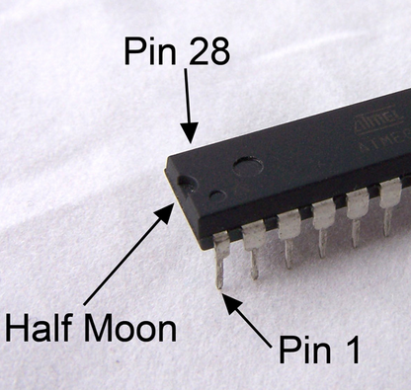
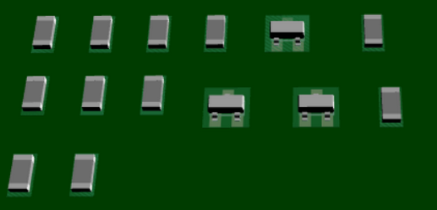
Component placement
90% of the time should be used for placement
Mechanical constrains
DRC rule set up
Put edge components first
Connectors, switches, jacks, USB ports…
Design the PCB layout like the schematic layout
ICs
Leave enough space
Keep them in the same direction
Keep similar components in the same direction
Keep at least 0.15mm between all components
If possible, put all components at top layer. (save costs)
Reference: https://www.autodesk.com/products/eagle/blog/top-10-pcb-component-placement-tips-pcb-beginner/

Slide 3
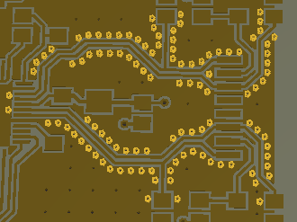
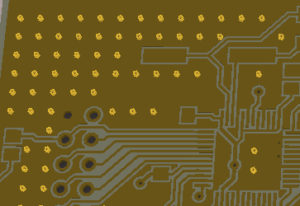
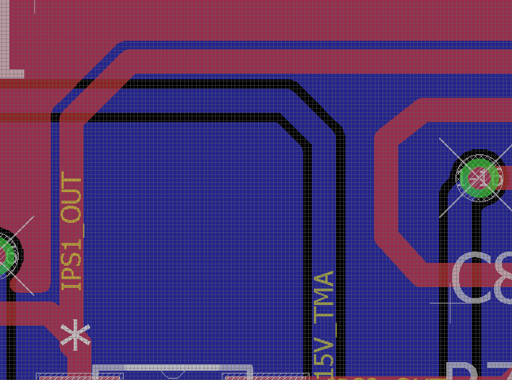
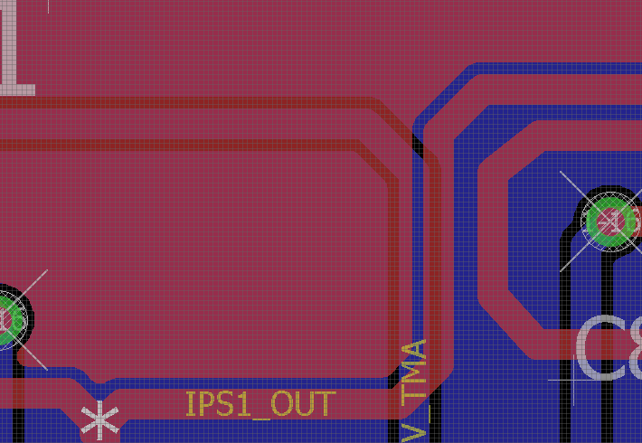
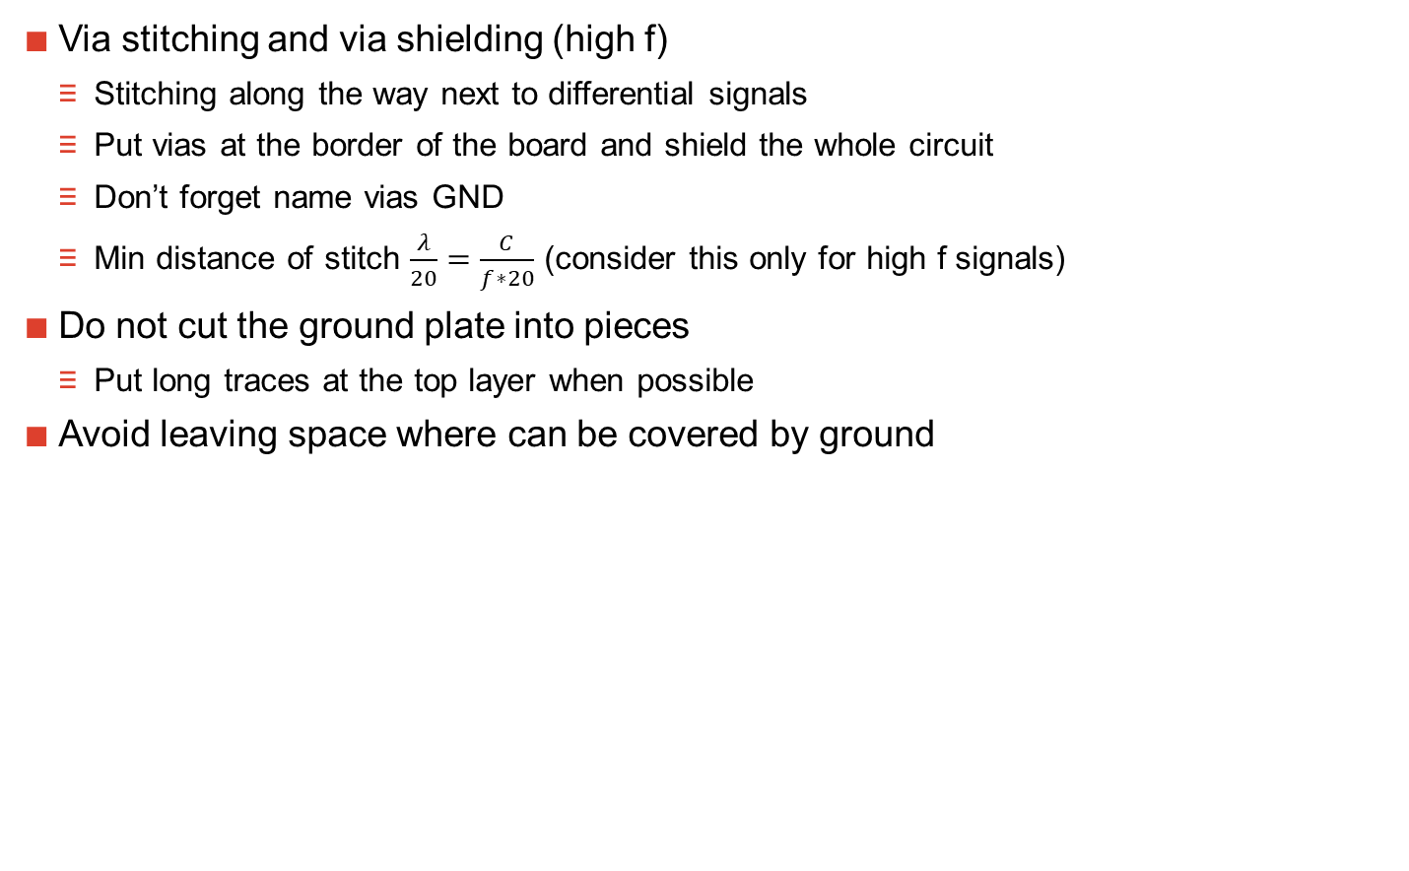
Component placement
Via stitching and via shielding (high f)
Stitching along the way next to differential signals
Put vias at the border of the board and shield the whole circuit
Don’t forget name vias GND
Min distance of stitch $\frac{λ}{20}=\frac{C}{f∗20}$ (consider this only for high f signals)
Do not cut the ground plate into pieces
Put long traces at the top layer when possible
Avoid leaving space where can be covered by ground
reference
Advice from Jakob

